Slide 1
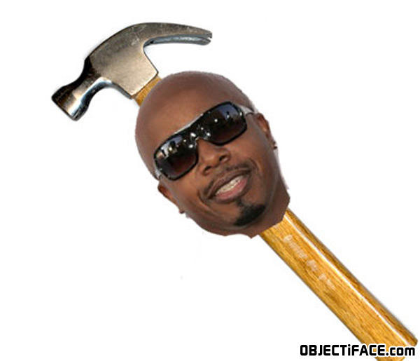
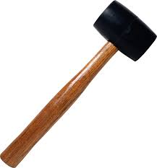
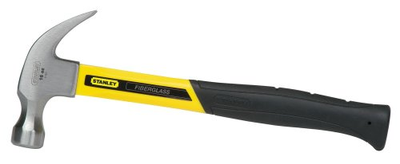
Hammers, Mallets, and MC
Coach Ketcham Productions

Slide 3
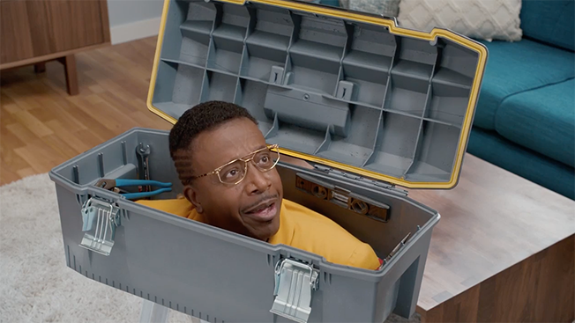

Slide 4
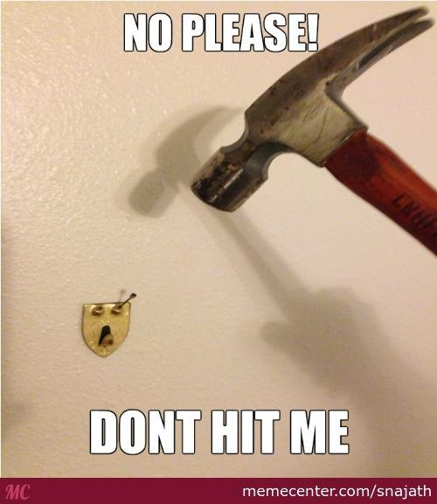

Slide 5
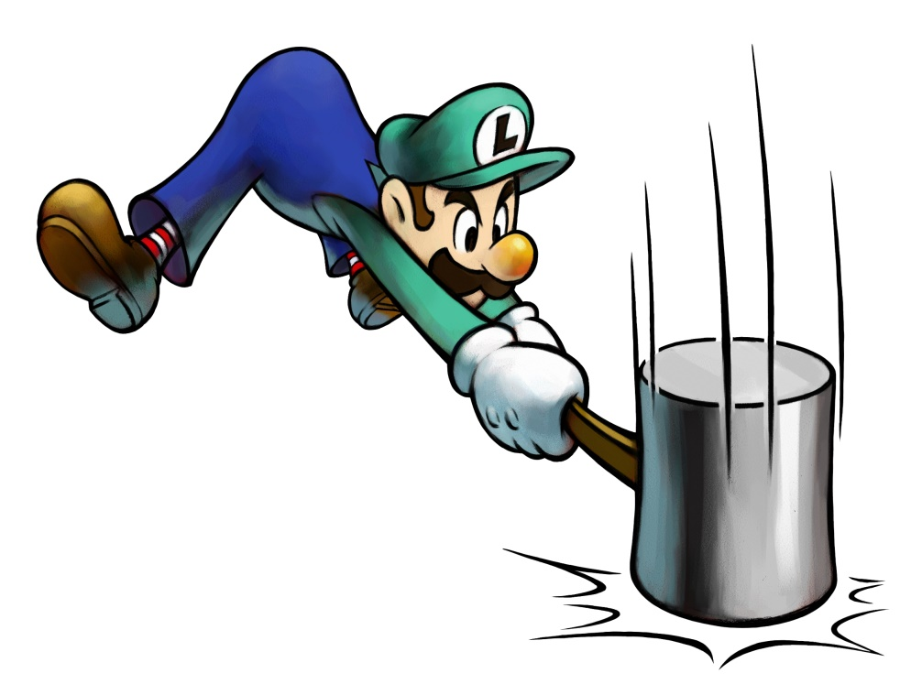
Hammers
Various types
Used to drive nails, pull nails and adjust boards or move objects.
Never strike one hammer head against another. The force could break both hammers and cause an eye injury.

Slide 6
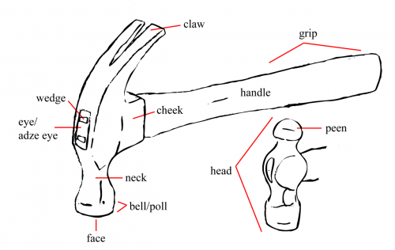
Hammer Parts ID

Slide 7
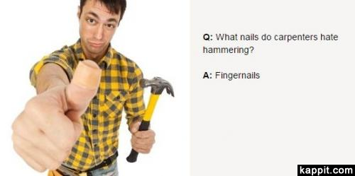
Types of Hammers

Slide 8
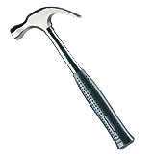
Claw Hammer
This classic hammer, with the claw shaped to maximize leverage, is ideal for removing nails. It is the standard all-purpose hammer and an indispensable object in any tool box.

Slide 9
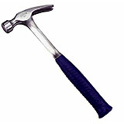
Straight Claw Hammer
When nails are too close to a wall or ceiling, the claw hammer handle may hinder your nail pulling efforts. The straight claw hammer would be more effective in these situations, while having other practical uses as well (Ex: as a chisel).

Slide 10
Drywall Hammer
With its rounded and slightly grooved hammering surface, the drywall hammer allows you to sink gypsum nails without damaging or denting the board and helps improve the hold of the joint compound. Its distinctive flat claw also allows you to remove nails easily without damaging the board.
Minimal Theatre usage, but can be handy from time to time.

Slide 11
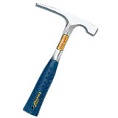
Bricklayer’s Hammer
Specialized tool with a flat edge for carving bricks and a hammering surface for placing them, the bricklayer’s hammer is made of a specially designed metal for maximum performance with masonry materials.
Not much of a Theatre use

Slide 12
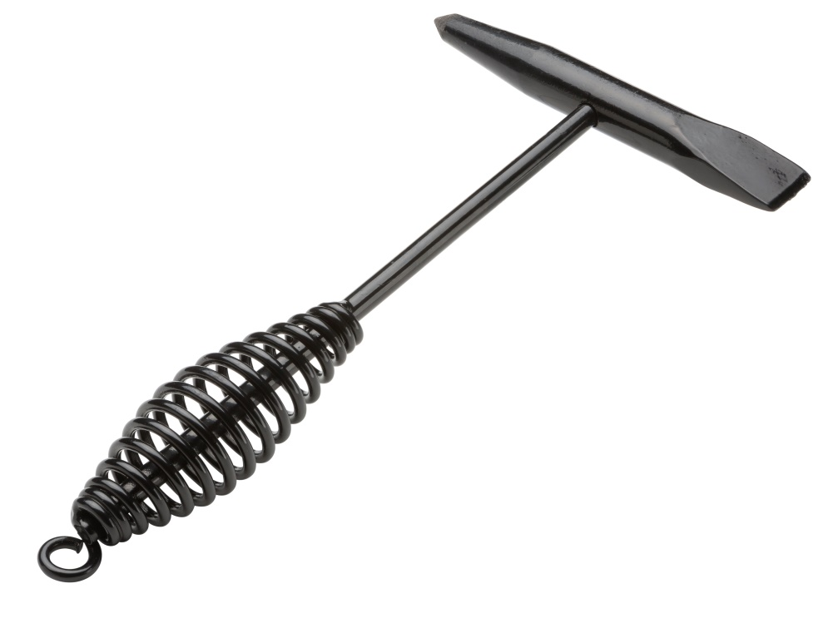
Welder’s Hammer
Multi-purpose hammer designed for various welding applications (such as the removal of unwanted fragments using either the hammering surface or the pointed claw), the welder’s hammer is made with softer metal than standard hammers and, as such, is more resistant to repeated impacts on metal.
Theatre Use: We will weld from time to time. Handy tool.

Slide 13
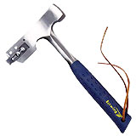
Shingler’s Hammer
Specifically designed for the installation of roofing shingles, the shingler’s hammer comes equipped with a blade used to trim asphalt and cedar shingles.
Theatre Use: Not a chance I’m trusting you with a hammer with a blade. Sorry.

Slide 14
Ball-Peen Hammer
Much like the welder’s hammer, this tool is designed to work on metals, but unlike the welder’s hammer, its rounded head is used primarily to shape metal surfaces. It is also a more compact tool than its soft-headed cousin, making it easier to work with in small areas or hard-to-reach places.
Theatre Use: Minimal

Slide 15
Mallet
Rubber headed hammer used in applications where you need to strike a surface without causing damage; when installing floor boards or hubcaps for instance. Typically made of black rubber, mallet heads are also available in white rubber, which helps prevent surface marks.
Theatre Use: closing paint can lids, knocking carriage bolts in, adjusting boards.

Slide 16
Sledgehammer
Available with a long handle for hammering in pilings or a short one for striking a cold chisel, sledgehammers can be used to hammer concrete, wood or metal objects without fear of damaging the tool.
Theatre Use: Adjusting attitudes of students

Slide 17
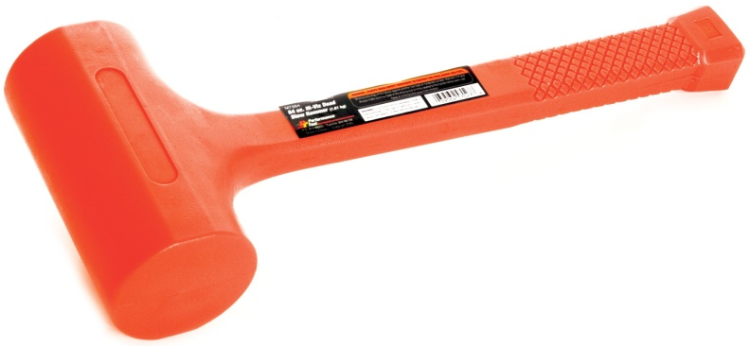
Dead Blow Hammer
The head of a dead blow hammer is commonly hollow and partially filled with loose sand, lead shot, or steel shot, which distribute the energy of the strike over a longer period of time.
Dead blow hammers are used in theatre to knock joints together or apart without denting the wood pieces being worked on.

Slide 18
How to use a Hammer
https://www.youtube.com/watch?v=3QBYNh-JVxg

Slide 19
Types of Hammer Handles
Hammers are typically built with metal, wood or fiberglass handles.
There is no one type of handle that is better than the rest; it’s all about how the handle feels in your hand, thus the importance of trying the tool out.
This being said, a wood handle is ideal for working in areas in close proximity with sources of extreme heat (Ex: in some factories) as the wood will not conduct heat.
Note that wood handled hammers are usually less expensive and provide another interesting advantage - the handle can be replaced.
However, some users find that hammers made with metal and fiberglass handles offer better control when hammering.

Slide 20
Types of Hammer Handles
Over the last few years, manufacturers began offering hammers with anti-vibration handles. These tools can, depending on the model, reduce the amount of vibration felt by the user from three to eight times when compared to a regular hammer. A significant advantage for everyday users!

Slide 21
Types of Hammer Heads
The hammer head is comprised of a hammering surface and a claw. The claw may be straight or curved and can be used to straighten or pull nails.
In general terms, forged steel heads provide better quality than molded heads, which have a tendency to become damaged with use.

Slide 22
Types of Hammer Heads
Some hammers have a “textured” striking surface to avoid slippage but keep in mind that these models tend to damage the hammering surface and cause more serious injuries when fingers get hit.
This type of head is not to be confused with the drywall hammer, which is slightly rounded and finely textured to minimize the risk of damage to the drywall board and to create small relief on the board in order to improve the hold of the joint compound.

Slide 23
Types of Hammer Heads
Finally, there are a few standard hammers that come equipped with a notch where nails may be inserted, thus allowing users to “start” the nail with a hammer strike.

Slide 24
Various Hammer Weights
Regardless of handle material, standard hammers are offered in 8, 13, 16, 20 and 22-ounce models: a 16-oz. hammer with wood handle will weigh the same as a 16-oz. hammer with a fibreglass handle.
Though 8-oz. hammers can be useful for small jobs, 16-oz. versions, with their optimal weight to handling ratio, are the ultimate all-purpose models.
20 and 22-oz. hammers are usually intended for use by professionals, in carpentry or demolition applications for example.
The 13-oz. hammer, designed for finishing applications such as the installation of baseboards and mouldings, is gradually disappearing and is being replaced by compressed air hammers.

Slide 25
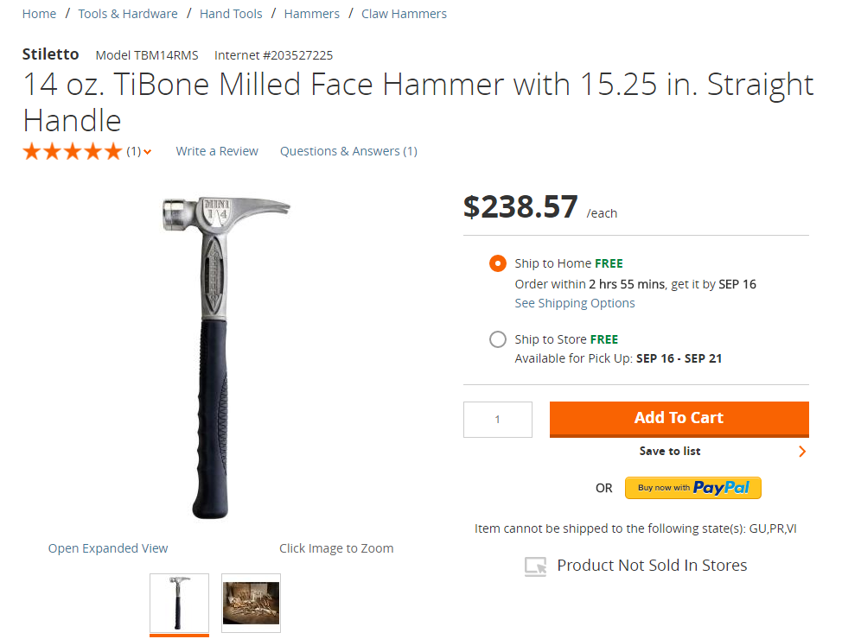

Slide 26
Hammer Maintenance
It is recommended that hammers be stored in a dry location and that they be wiped down if wet.
To avoid injury, never leave any tool within reach of a child.
Use added caution when using a tool in proximity to electrical installations.
Always wear safety glasses.
Grip the hammer firmly and strike using the entire arm and not only the wrist.
Never use a hammer with a damaged handle or head.
Always look behind you before starting the required swing to make your strike.

Slide 27
Quiz
11
10
6
8
7
5
9
1
4
2
3

