Slide 1


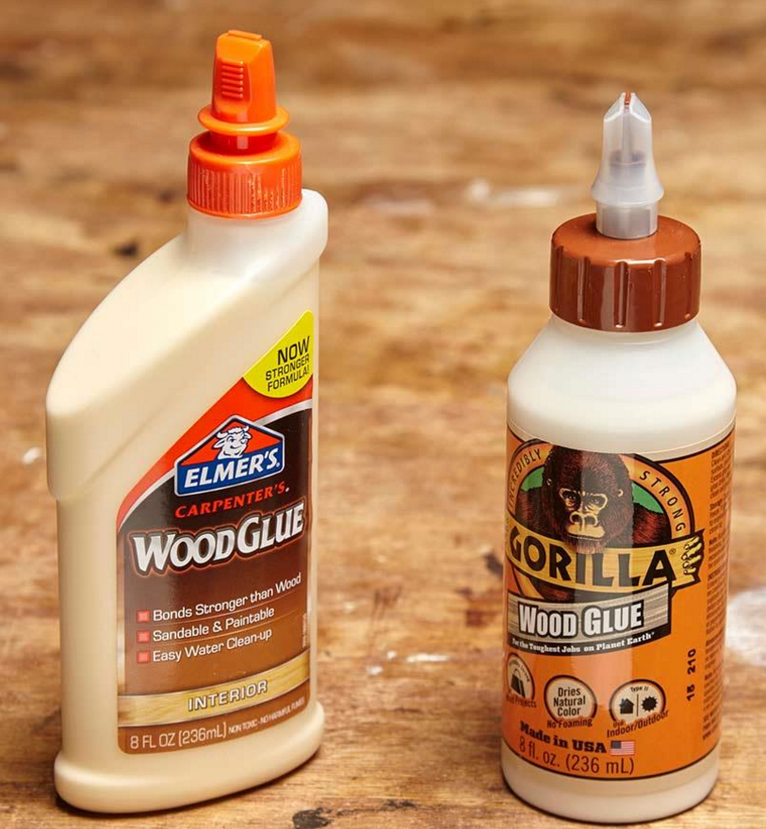
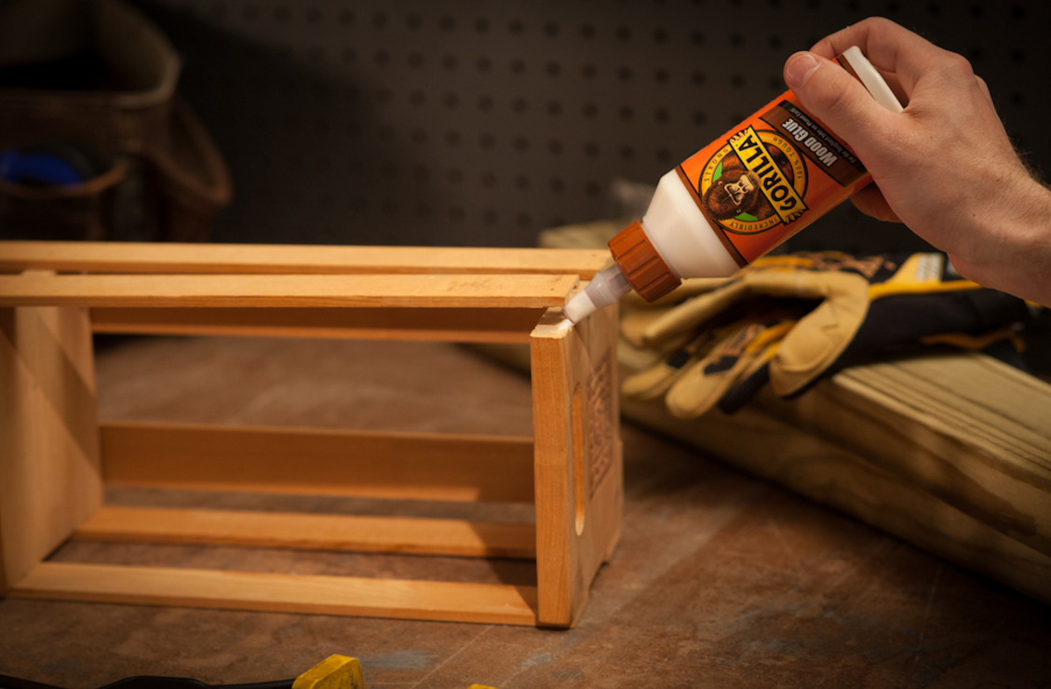
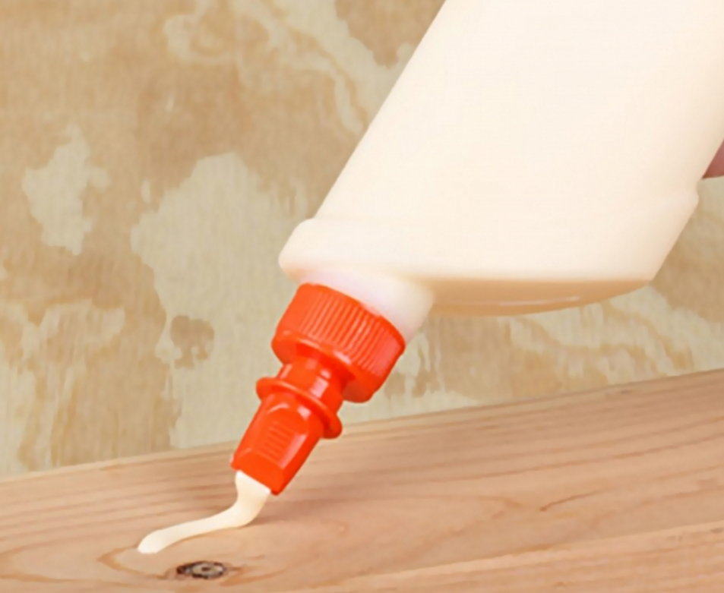
Glue
Coach Ketcham Productions

Slide 2
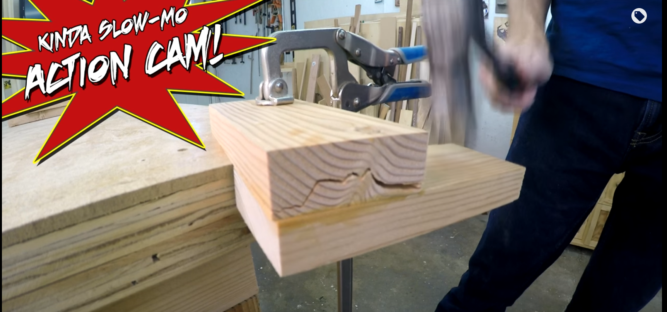
Glue
Best way to hold wood together
  Holds better than screws or nails
  Glue is often stronger than the wood itself.

Slide 3
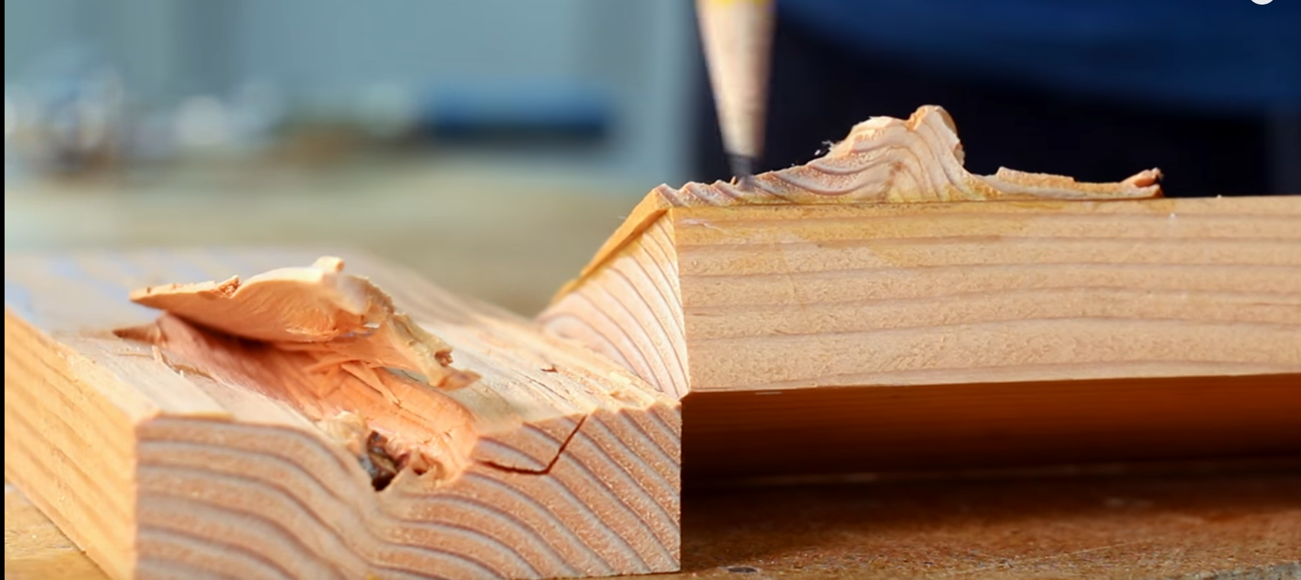
Wood Glue
The area glued up still remains

Slide 4
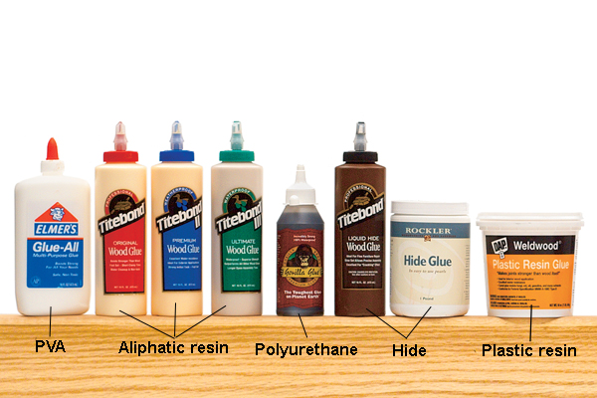
Types of Glues
Super Glue
Hot Glue
Wood Glue
Epoxy
Contact Cement
Spray Adhesive

Slide 5
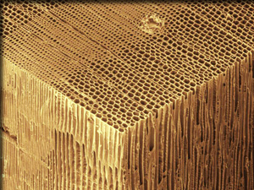
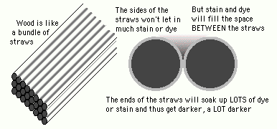
End Grain is like a bundle of straws

Slide 6
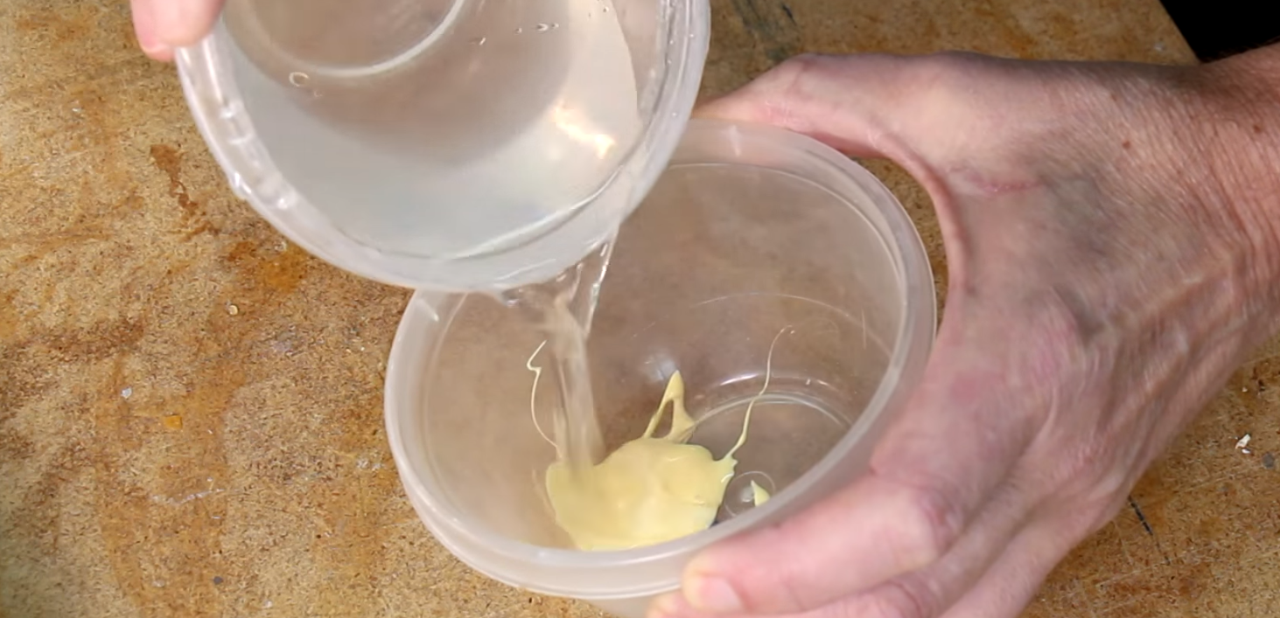
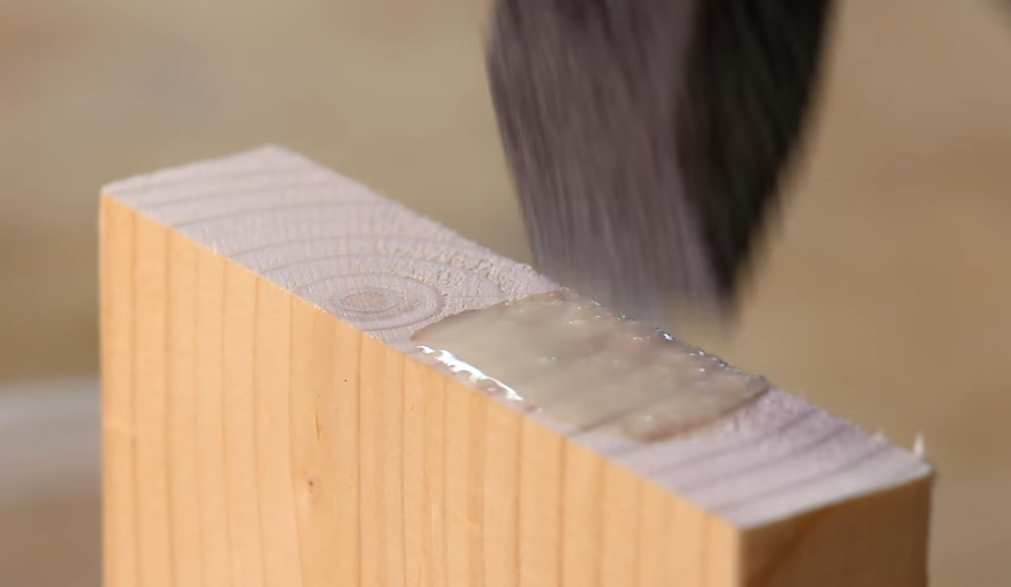
How to Deal with End Grain
End Grain soaks up glue
Make a sizing
  ½ Glue
  ½ Water
  Brush on endgrain
  Wait for it to dry, add regular glue and go

Slide 7
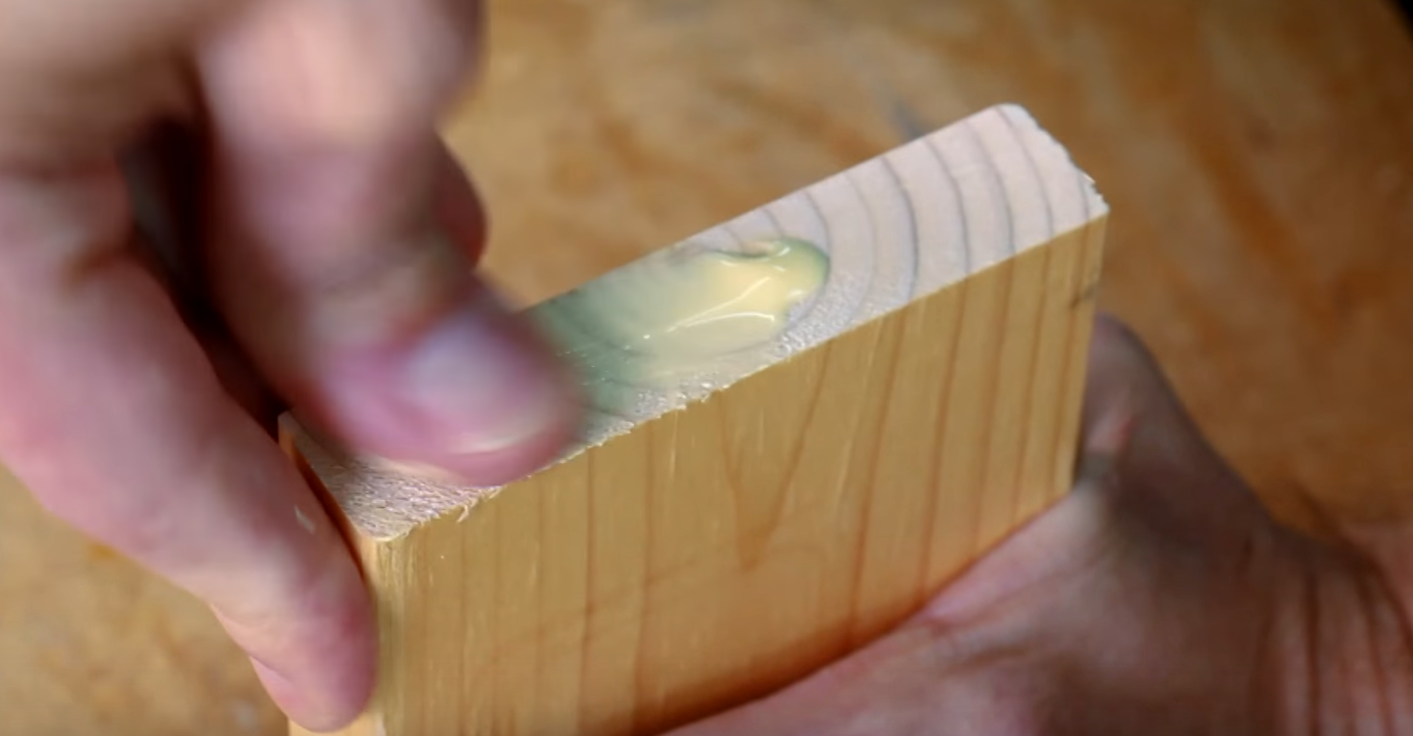
How to Deal with End Grain
Best Glued on Face and Edge Grain
End Grain, not real great.
End Grain soaks up glue
Just use your finger and force the glue into the endgrain.
Let dry a few minutes and glue up as usual.

Slide 8
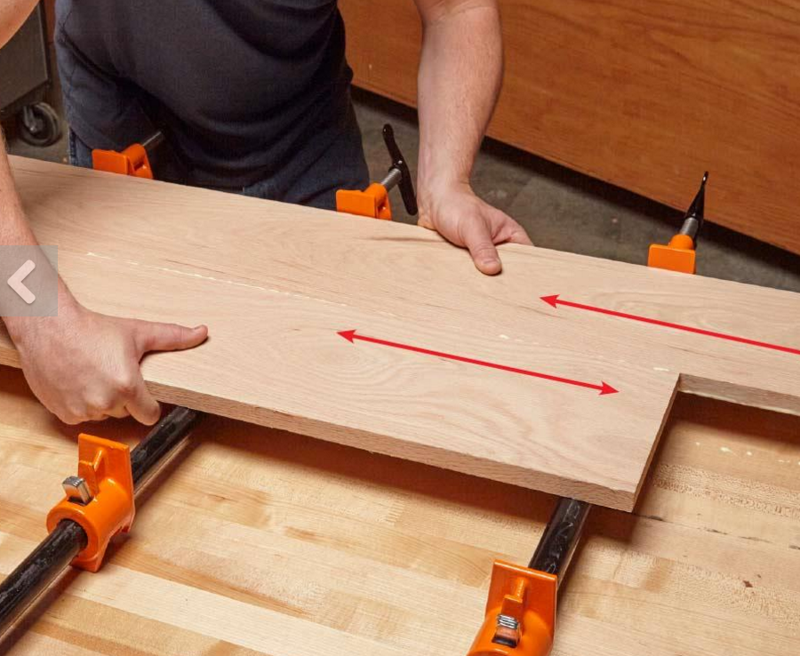
Rub the Joint
One good way to ensure a strong glue joint is to use the “rub joint” method. Simply apply glue to the edges of one or both boards and rub them together to help spread the glue evenly before clamping.

Slide 9
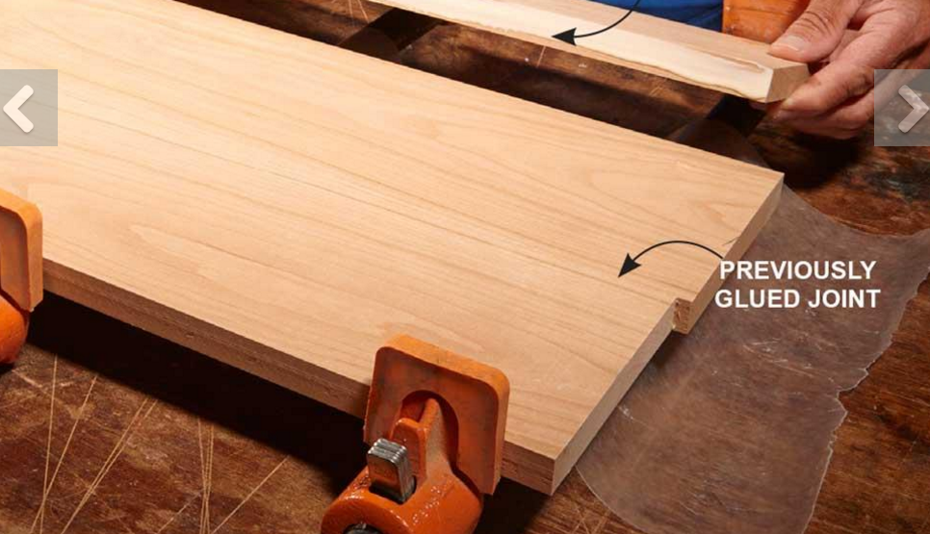
Add One Board at a Time
When you're gluing several boards together, it can be difficult to get all the top surfaces perfectly aligned. Here's a tip that solves the problem. Rather than glue and clamp all the boards at once, add one board at a time.
Let the glue joint set for about 20 to 30 minutes, then release the clamps and add another board. This method will take a little longer. But it makes it a lot easier to keep all of the boards' top surfaces flush, which makes for much easier flattening and sanding of the surface.

Slide 10
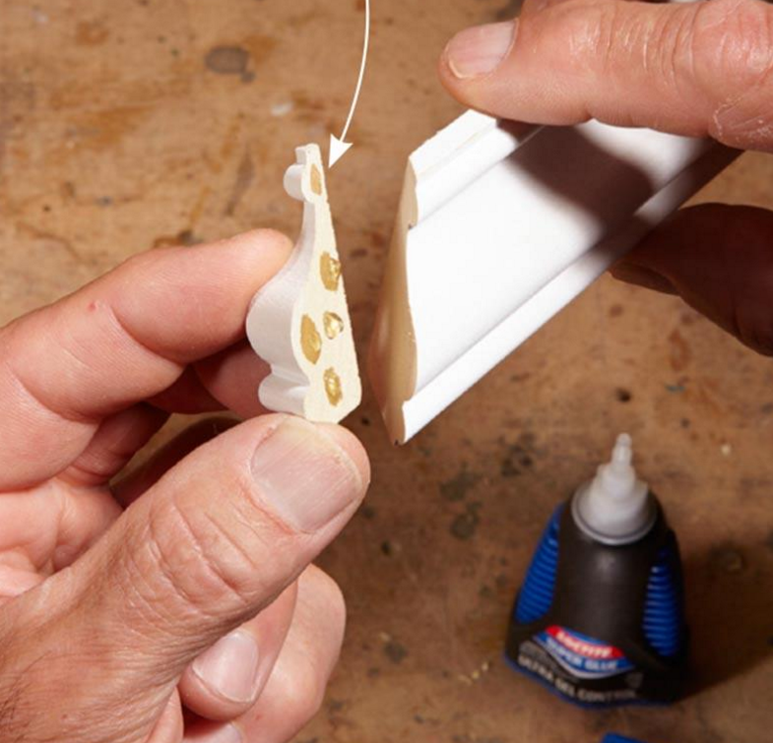
Attach Small Pieces With Superglue
Of course you reach for a superglue (cyanocacrylate glue, or CA) to fix a broken teacup handle. But did you know that it works on wood, too?
In fact, CA glue is really handy for attaching small trim pieces that would be hard to clamp. Just put three or four drops onto the parts and stick them together.
Coach Ketcham likes the gel version of CA glue because it doesn't run off and make a mess.

Slide 11
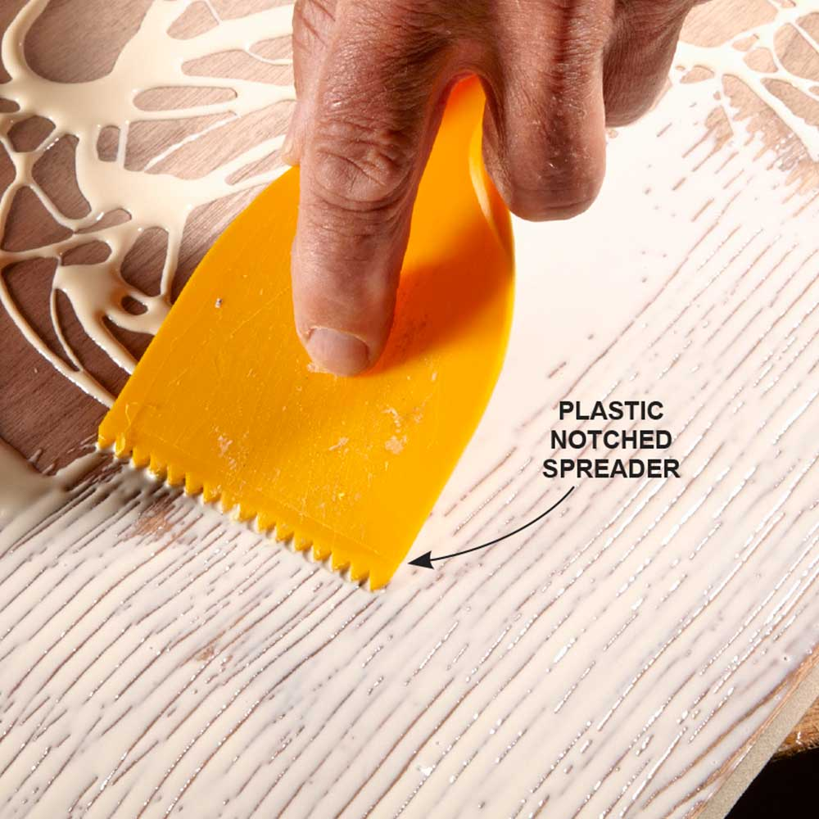
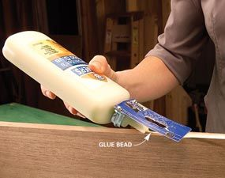
How to Spread Glue
When you're gluing large surfaces, an inexpensive notched plastic trowel works great for spreading the glue.
You can make our own spreader from an expired credit card.

Slide 12
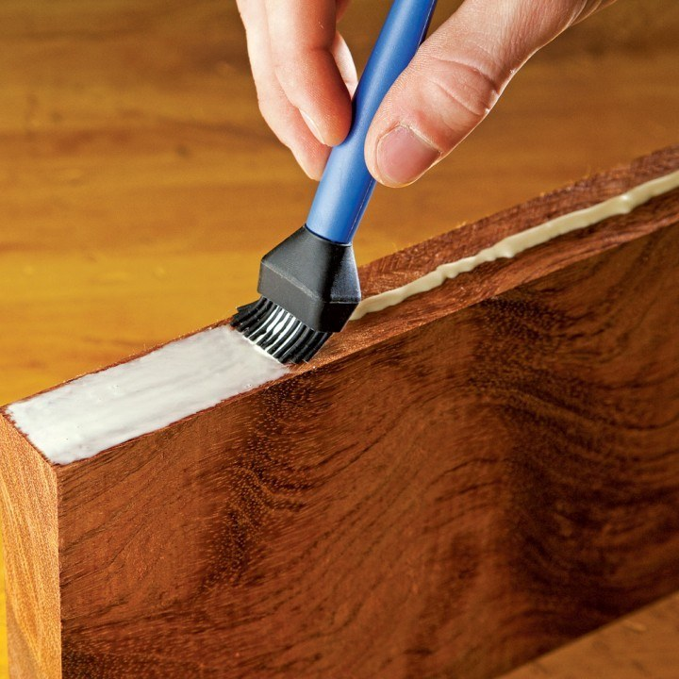
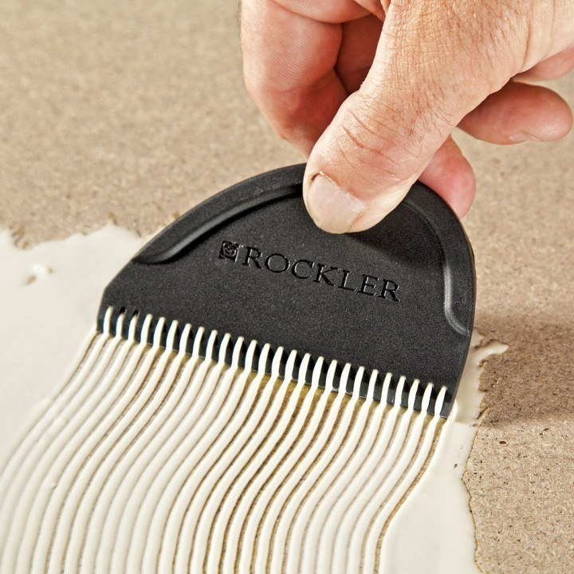
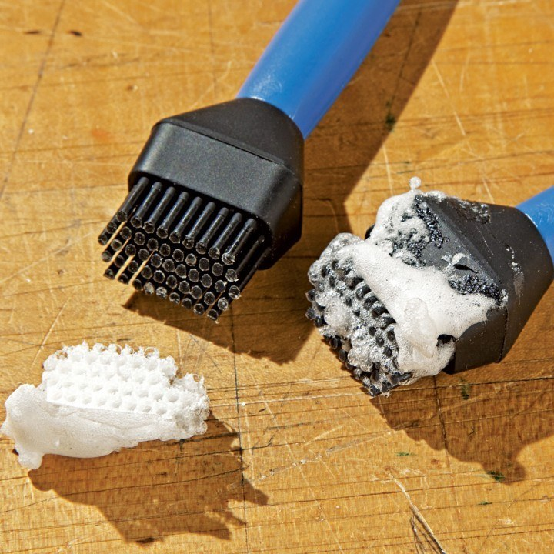

Slide 13
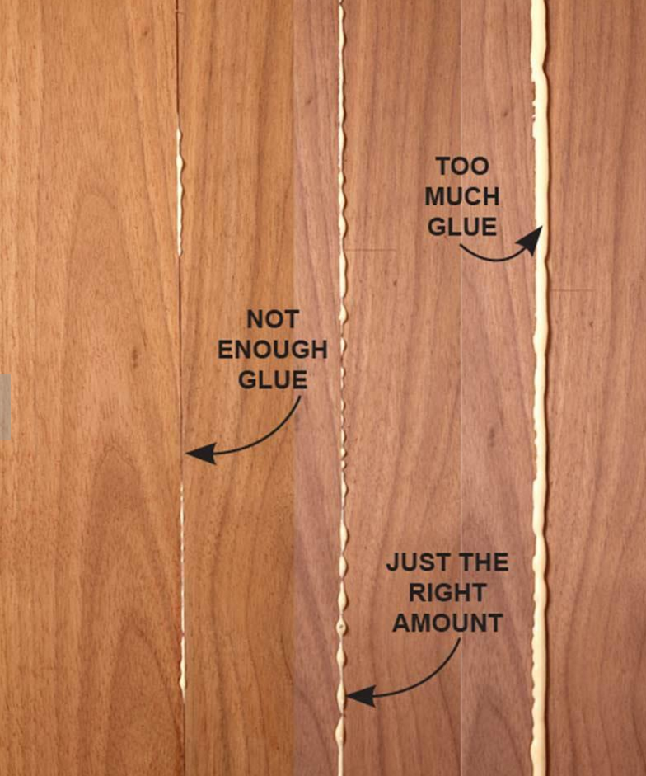
The Right Amount of Glue
With a little experience, you'll develop a feel for how much glue is just enough. Too little glue creates a “starved joint,” which will be weak.
Too much glue makes a mess and wastes glue. With practice, you'll know just how much to apply.
You should see a continuous line of small glue beads.
When this perfect glue joint sets a little, you'll find it easy to scrape off the jelled excess, and you'll have very little cleanup to do.

Slide 14
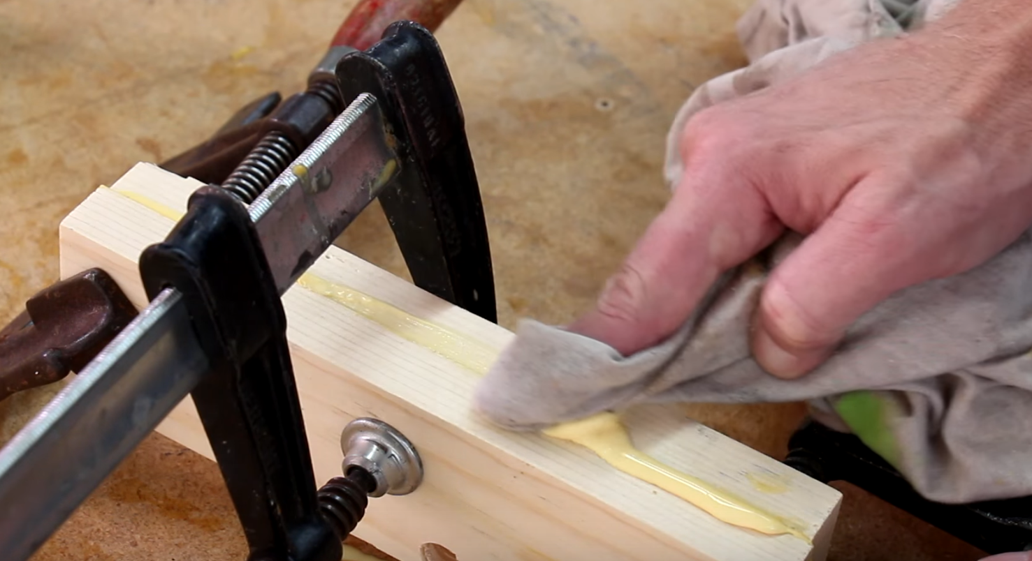
Wipe Off Extra Glue

Slide 15
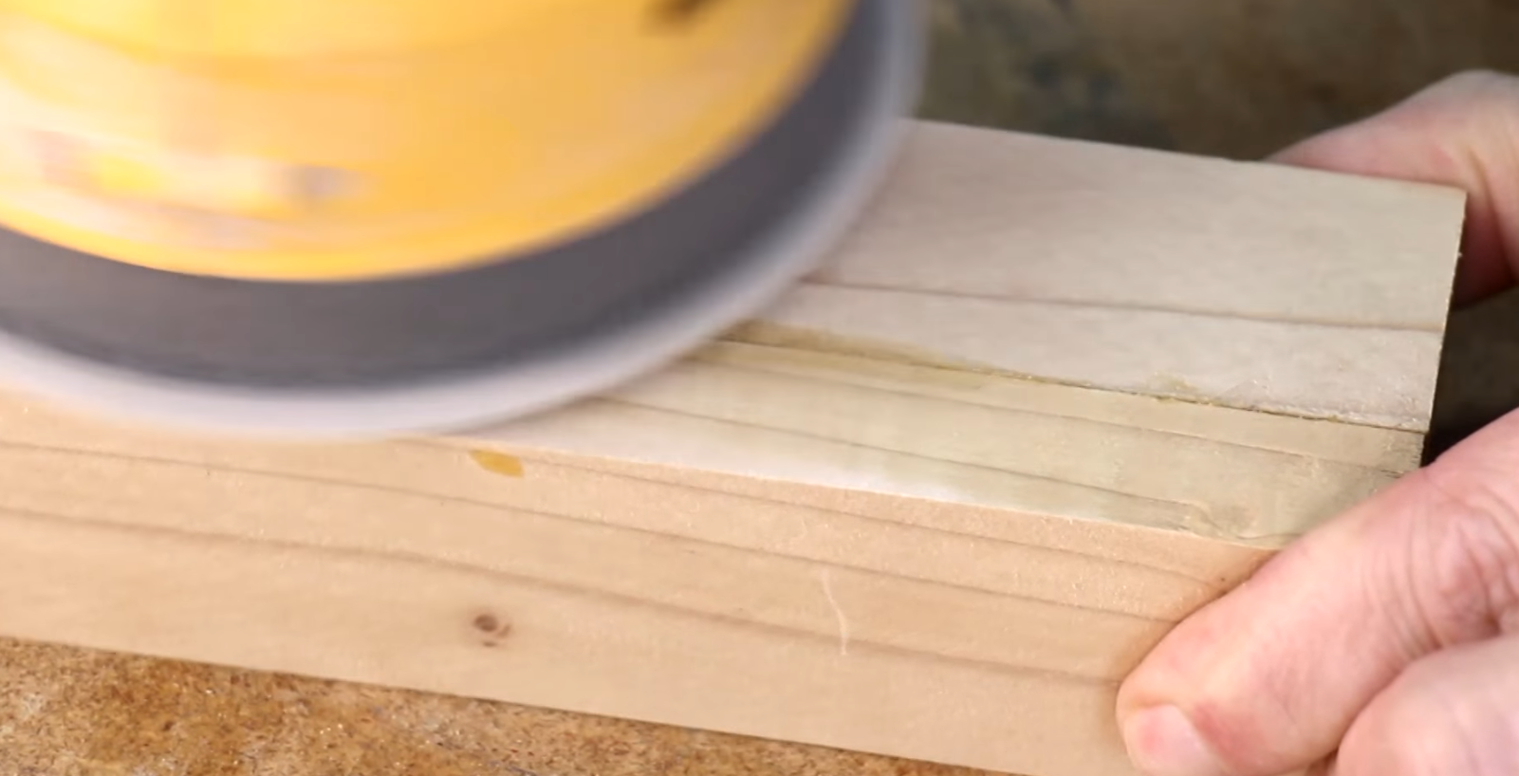
After 45 minutes to an hour
Sand off extra glue

Slide 16
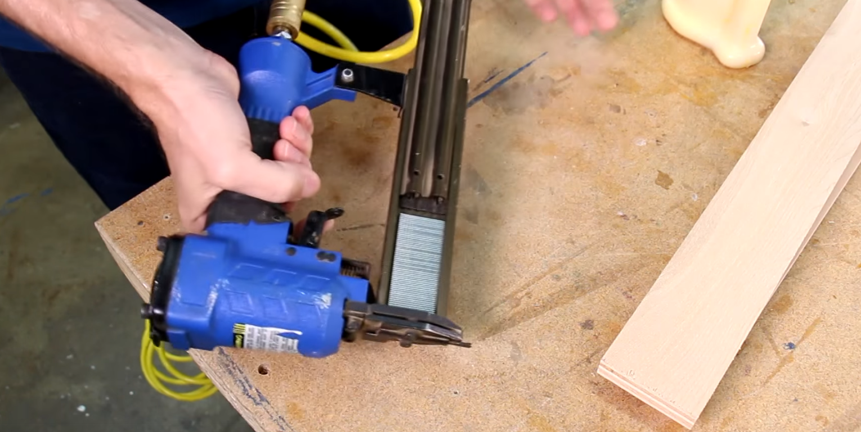
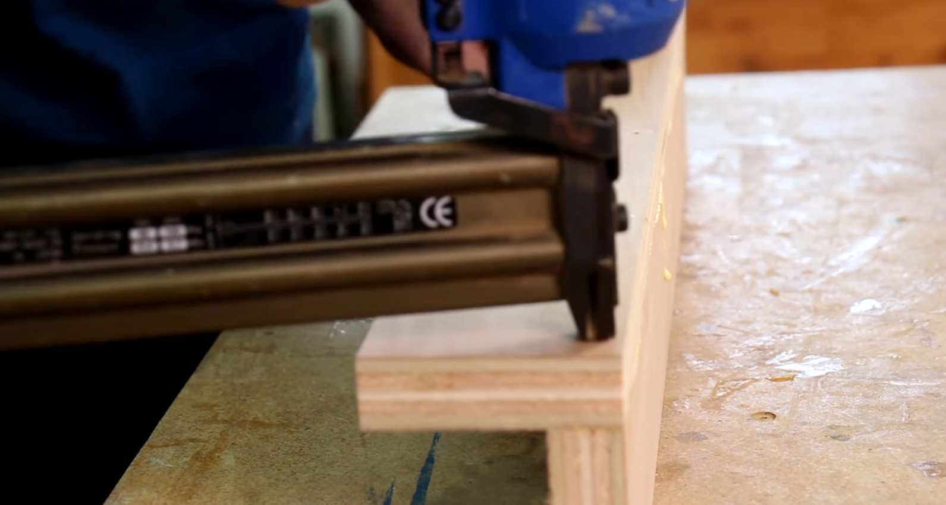
Clamps or Nails
Clamps work great
You can also glue and use some small brad nails as a mechanical clamp.

Slide 17
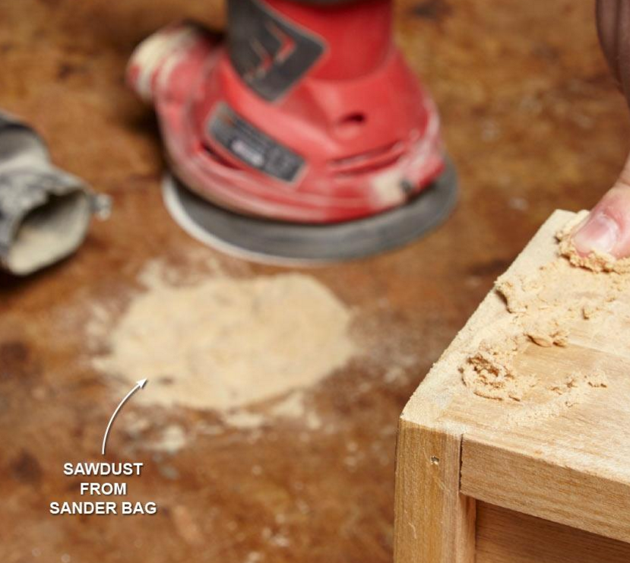
Glue + Sawdust = Wood Filler
When you need wood filler that matches the color of your project, mix some fine sawdust and glue together until it forms a paste, which you can use to fill small gaps and cracks.
For best results, use sawdust from the same species of wood as your project; you can get some from the bag on your electric sander.
Just don’t try this trick for large gaps or patches—they’ll stick out like a sore thumb.

Slide 18
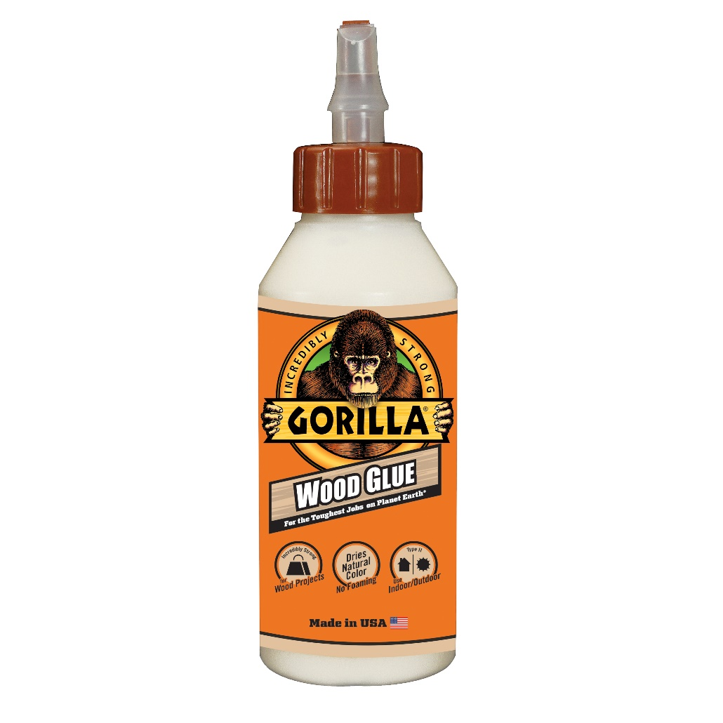
Yellow Wood Glue
Great Glue
Complete Projects Faster: Requires only 20-30 minutes of clamp time, fully cured in 24 hours.
Use Indoors or Outdoors: water resistance.
Versatile: Ideal for use on hardwoods, softwoods, and natural wood composites.
Dries natural color: Offering a natural bond line.

Slide 19
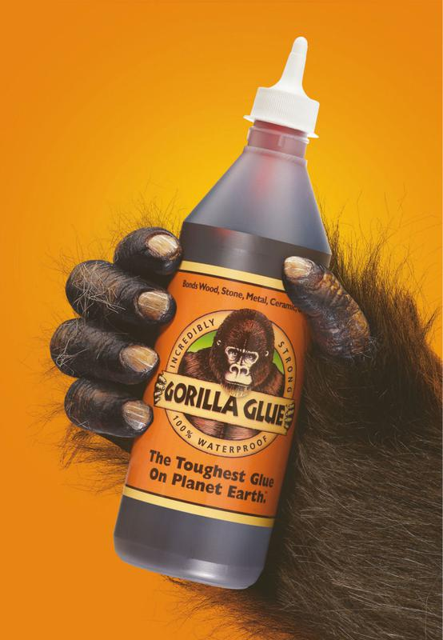
Polyurethane Glue
100% Waterproof: Doesn't break down when exposed to outdoor elements
Versatile: Easily bonds wood, stone, metal, ceramic, foam, glass, concrete and much more!
Incredibly Strong: Expands 3 times into the materials to form an incredibly strong bond
Temperature Resistant: Unaffected by hot and cold temperatures.
Is not coming apart and not coming off your hands easily.
Have to wet surface first.

Slide 20
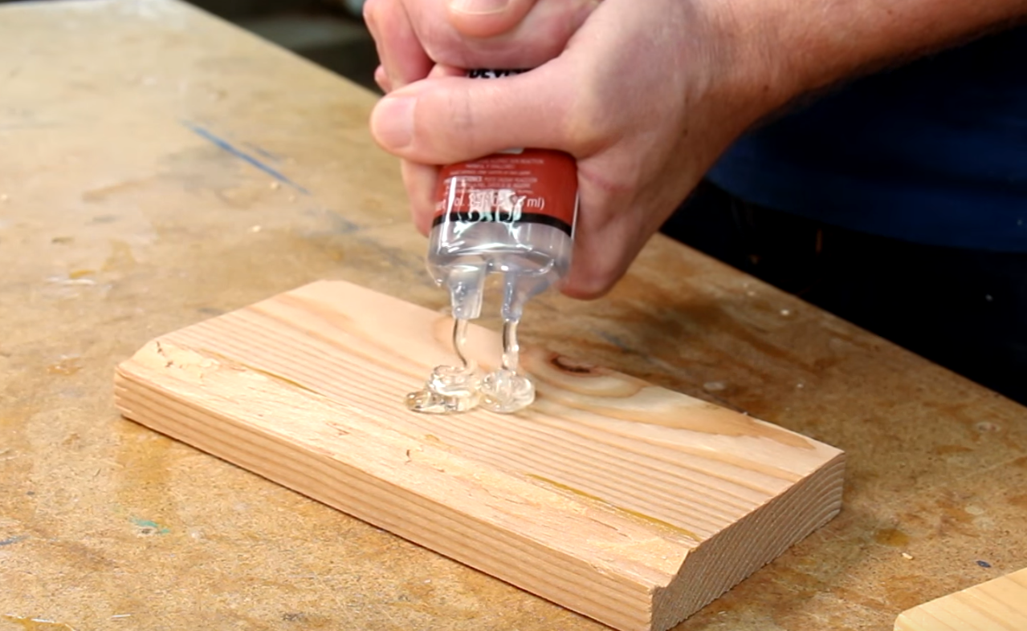
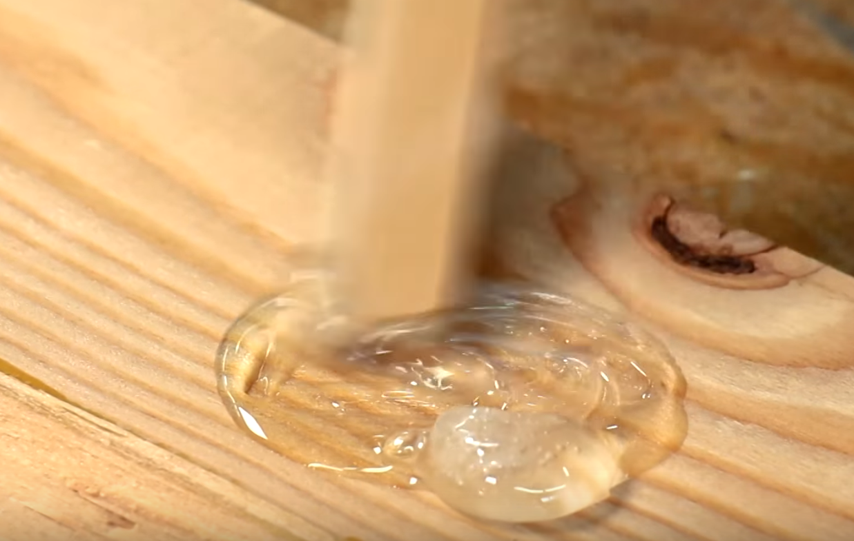
Epoxy
Usually comes in 2 parts
You mix it together really well
Dab it on parts you need
  Not cheap and messier than wood glue
  Can’t save it for later after mixing.

Slide 21
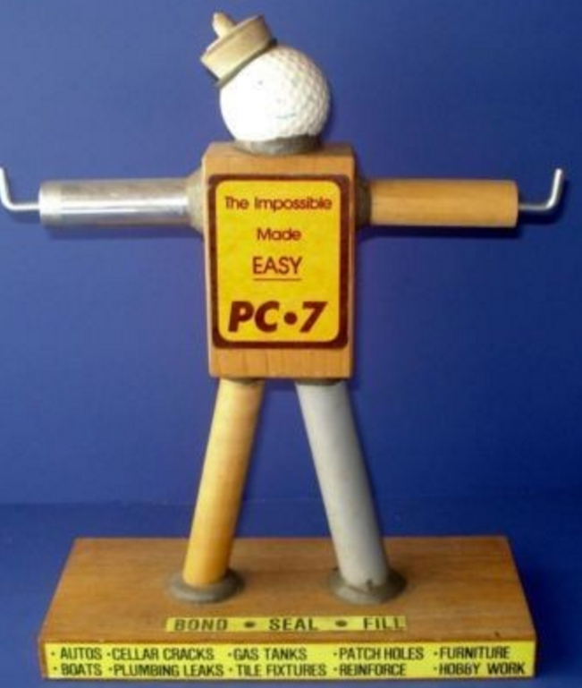
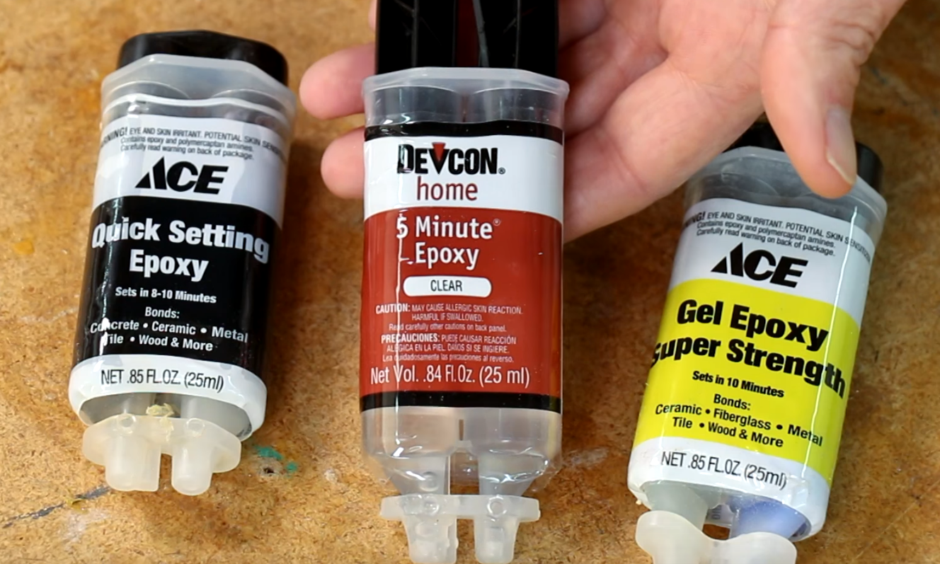
Non Wood Materials
Epoxy is best for metal, plastic, glass.

Slide 22
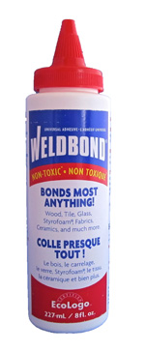
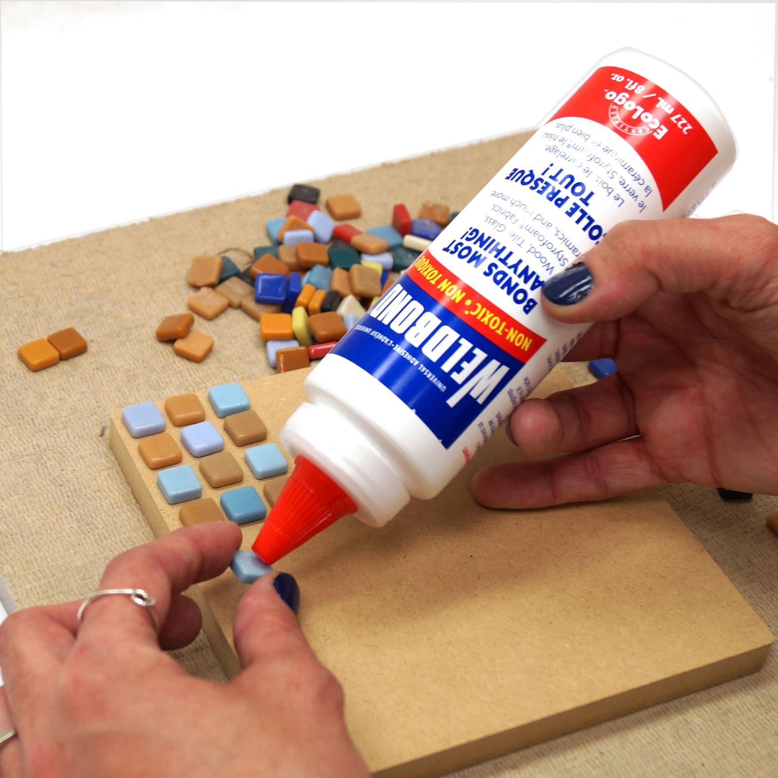
Weldbond
I just started using it
Bonds about anything
Painted boards, cardboard, china, cork, fabrics, foam plastic, furniture, leather, marble, paper, plastic laminates, plywood, rope, slate, stone, veneers, cement, concrete, bricks, plaster, metal, glass, wood, tiles, building panels, and more.

Slide 23
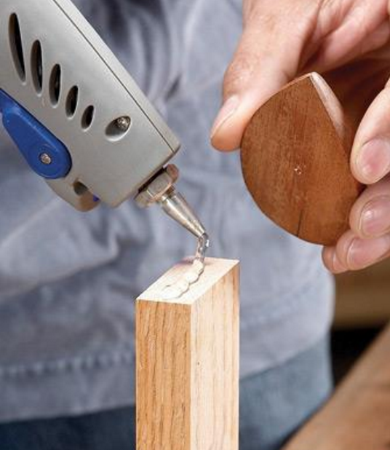
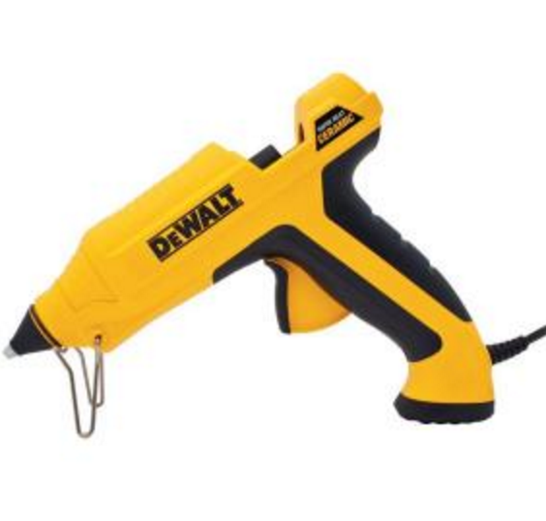
Hot Glue
Great for crafts
Hot glue holds small stuff better than clamps
When you have to cut, shape, file, sand or finish something small, reach for your hot glue gun and glue the piece to a pedestal stick.
The hot glue will hold just about anything as well as or better than any clamp ever could—if using a clamp is even possible.
When your project is complete, try to pop it loose with a putty knife, but don't use too much force—you might tear out the wood or break the piece.

Slide 24

https://www.youtube.com/watch?v=yCh0yYxaGzg

