Slide 1
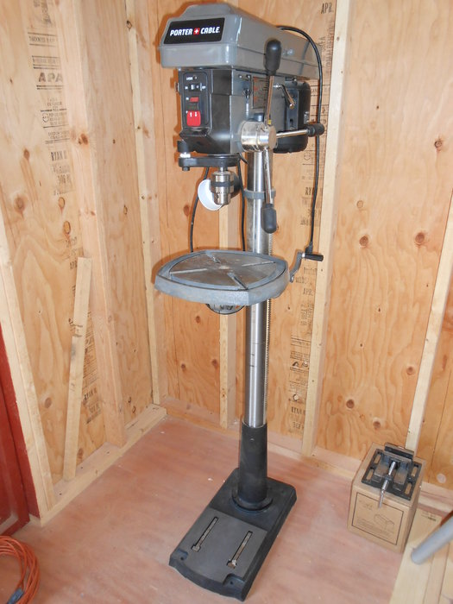
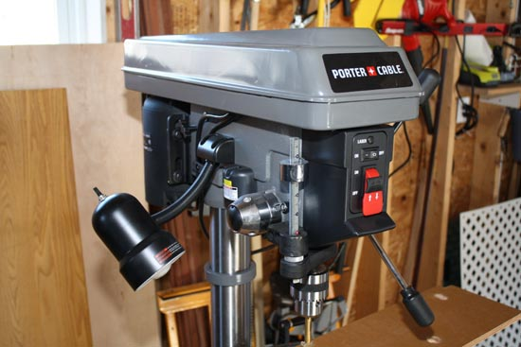
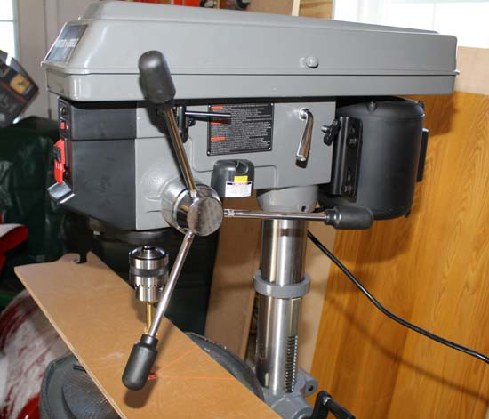
Drill Press
Coach Ketcham Productions

Slide 2
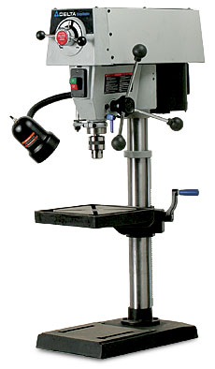
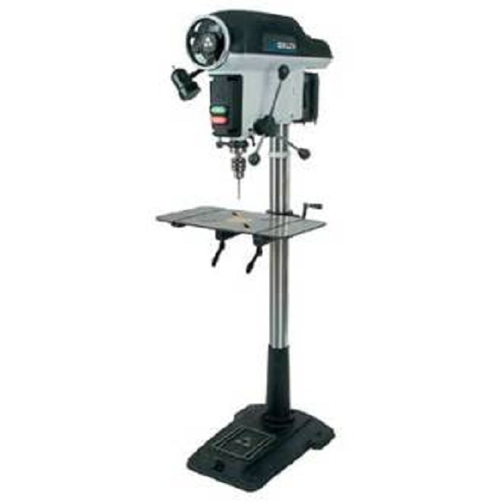
Introduction to the Drill Press
Floor Standing Drill Press
Bench-Top Drill Press

Slide 3
Parts of the Drill Press
(Hit arrow button on keyboard to make names of items appear)
1
Variable Speed Control
Head
7
2
On/Off Power Buttons
Motor
8
3
Lamp
Feed Lever
9
4
Chuck
Table-Height Adjustment Lever
10
Table
5
Column
11
6
Base

Slide 4
Lamp
The lamp provides extra light for drilling operations. It is a nice accessory to have on a drill press.

Slide 5
The “chuck” holds the drill bit securely in place. A “chuck key” is used to open and close the jaws of the chuck when changing drill bits. You must always tightly secure the drill bit in the chuck with the chuck key before drilling.
It is unsafe to leave the chuck key in the chuck after securing a drill bit in the chuck (it could fly out and hit someone if the power is turned on while the chuck key is still in the chuck).
Always remove the chuck key from the chuck before turning the power on.
Chuck

Slide 6
The “table” of the drill press is used to support the stock to be drilled. The table can be raised and lowered (and even tilted for special drilling operations).
Small pieces of stock should be held with a vise/clamp (because it is more difficult to hold on to small pieces of stock with just your hands).
You must hold the stock or vice/clamp securely with your left hand throughout the drilling process.
Table

Slide 7
The “base” of the drill press supports the column that is attached to it. The base is normally made of heavy cast-iron.
Base

Slide 8
Head
The “head” of the drill press contains the belt and pulleys that are attached to the motor.
Changing the position of the belt on the pulleys allows the drill press to run at variable speeds.
This can either be done automatically with the variable speed control handle OR if the drill press is not equipped with a variable speed control handle, then the belt can be changed to a different pulley manually (by hand) by lifting up the guard of the head.

Slide 9
Motor
The “motor” of the drill press converts electrical energy (current that flows along a wire) to mechanical energy (moving parts of the machine).

Slide 10
Feed Lever
The “feed lever” of the drill press is used to lower the drill bit into the stock being drilled.
When drilling deep holes it is important to partially back the drill bit out of the hole enough to allow the chips to come out of the hole. Doing this prevents the chips from becoming stuck inside the hole. It also prevents the bit from heating up, becoming dull, and burning your project.

Slide 11
The “column” of the drill press supports the table and head of the drill press. Floor standing drill presses have a longer column than bench-top drill presses in order to give the drill press a taller height.
Column

Slide 12
Table-Height Adjustment Lever
The “table-height adjustment lever” allows you to easily raise and lower the table of the drill press. After adjusting the height of the table, you must be sure to tighten the “table lock nut(s)” which are located next to the height adjustment lever. Doing this will prevent the table from moving during the drilling operation.
Some drill presses do not have a table height adjustment lever. In that case, the table can be adjusted by temporarily loosing a table lock lever and carefully adjusting the table to the desired height by hand, and then locking it into place again.

Slide 13
Safe and Proper Practices for the Drill Press
1. Use sharp drill bits only. Do not use dull drill bits.
2. Fasten the drill bit securely in the chuck with a chuck key.
3. Do not excessively force the drill bit into your work while drilling.
4. Always clamp or hold your stock securely when drilling.
5. Clamp small pieces with a vice clamp.
6. Turn the power off immediately if your stock begins to spin around with the bit.
7. Set up and operate so as not to damage the table of the drill press or any clamping devices.
8. Keep your stock (or clamping device) flat on the table of the drill press while drilling.
9. Remove unneeded tools and materials from the table before drilling.
10. Always remove the chuck key from the chuck before drilling.
11. Use your left hand to hold your stock while drilling.
12. Use your right hand to control the feed lever.
13. Keep hair and other dangling items away from the moving drill bit, wear safety glasses.
14. Never reach around the drill bit while it is moving.

Slide 14
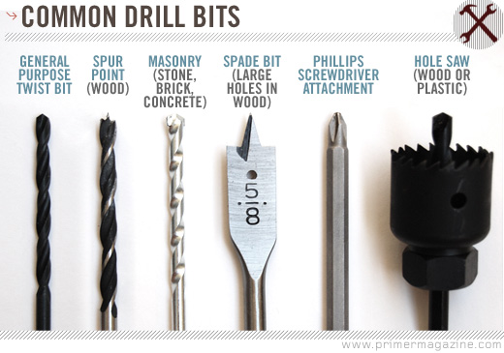
Types of Drill Bits

